Slide 1
IBM University Engagement Project Submission
“Exploring the Power of Agentic AI with IBM Granite and IBM Cloud , IBM BOB”

Slide 2

Project Tile – [Library AI Agent]
Domain of Project – [Education / EdTech]
Student Name | Recent Passport Photo | Email ID | Mobile number [WhatsApp]
Sidharth Kumar |  | SkillsBuild/Credly/ Ibm Cloud /watsonx Ai /IBM Bob / Attendence Email id is sidharthkumar7177@gmail.com AICTE: sidharthkumar7718@gmail.com | 9696042135
Recommended font style and size:
Font Style: Arial
Font Size (Heading): 28
Font Size (Content): 20

Slide 3
Problem Statement No. 21 – Library AI Agent
The Challenge
A Library AI Agent is an intelligent system designed to assist students in finding suitable learning materials based on their academic needs. It can analyze student profiles, study topics, and course syllabi to recommend relevant books and other educational resources.
Using Natural Language Processing (NLP), the agent understands student queries and matches them with appropriate books available in the library database. It can also check real-time book availability, prioritize high-demand titles, and assist students with book reservations and waitlist management.
The Library AI Agent saves time by streamlining the process of searching for learning materials and providing personalized recommendations aligned with the student's current academic requirements. It improves access to educational resources, increases student engagement, and promotes better utilization of library resources.
Technology Requirements
IBM Cloud Lite services – Mandatory
IBM Granite – Mandatory
Natural Language Processing (NLP)
Library database for book information and availability
AI-based personalized recommendation system
Book reservation and waitlist functionality

Slide 4
Proposed Solution -
Proposed Solution: AI-Powered Library Agent
The proposed solution is an AI-powered Library Agent built using IBM Granite, IBM watsonx.ai, and IBM Cloud Lite to help students quickly find relevant learning resources based on their academic needs. The system understands natural-language queries and provides personalized book recommendations from the library catalog.
At its core, the solution uses IBM Granite to understand student queries, identify relevant subjects and topics, and recommend suitable books based on factors such as course requirements, student level, and book availability.
The system provides several key features:
AI Book Recommendation helps students find relevant books by simply describing what they want to study.
Smart Search understands natural-language questions instead of relying only on keywords.
Real-Time Availability checks which books and copies are currently available in the library.
Reservation & Waitlist allows students to reserve available books and automatically join a waitlist when all copies are checked out.
Automatic Notifications informs students when a waitlisted book becomes available.
The solution includes a user-friendly web dashboard where students can interact with the AI agent, browse the library catalog, view their reserved books, and manage returns. The backend manages book availability, reservations, waitlists, and notifications.
IBM watsonx.ai provides the platform for integrating and using Granite models, while IBM Cloud Lite supports cloud deployment. IBM Bob was used to assist in developing the application and its workflows.
Overall, this solution delivers an end-to-end intelligent library assistant that saves students' time, improves access to learning resources, and reduces repetitive work for librarians through automated recommendations, reservations, waitlists, and notifications.

Slide 5
Technology Used-
IBM Granite Model – for eg – ibm/granite-4-h-small – For natural language understanding, reasoning, and personalized book recommendations based on student queries and academic context.
•
IBM watsonx.ai – For model deployment and AI inference. It hosts the Granite model and exposes the text generation API endpoint that our Library Agent calls for every student conversation.
•
IBM Cloud – It provides the infrastructure to build, deploy, and scale the Library Agent efficiently. IBM Cloud enables a reliable, secure, and scalable environment for deploying the Library AI Agent.
•
IBM Cloud IAM (Identity and Access Management) – For secure authentication. The IBM API Key is exchanged for a Bearer Token before every watsonx API call, ensuring the system is secure and access-controlled.
•
Node.js + Express.js – For building the backend REST API server that handles all business logic — book search, reservations, waitlist management, return processing, and notification dispatch.
•
HTML5 + CSS3 + JavaScript – For building the frontend Single Page Application — including the AI Chat interface, Book Catalog, My Books tab, and real-time Notification sidebar.
•
JSON File-based Database (db.json) – For persistent storage of reservations, waitlists, checked-out counts, and notification queues. Data survives server restarts — no student loses their reservation.
•
Prompt Engineering with Catalog Context Injection – The entire live library catalog is injected into every IBM Granite prompt, so the AI only recommends books that actually exist in the library — making it trustworthy and hallucination-free.

Slide 6
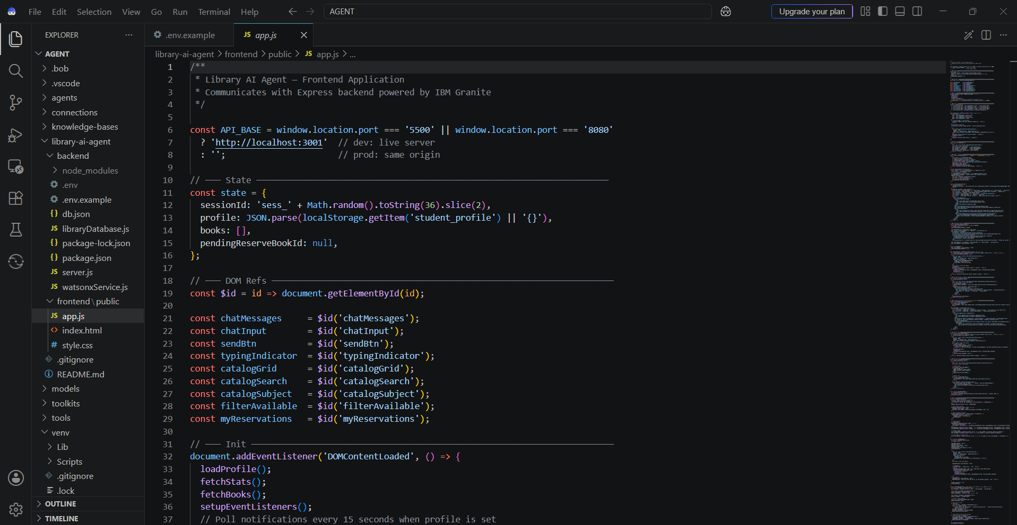
Required Files created using IBM bob –
App.js and server.js

Slide 7
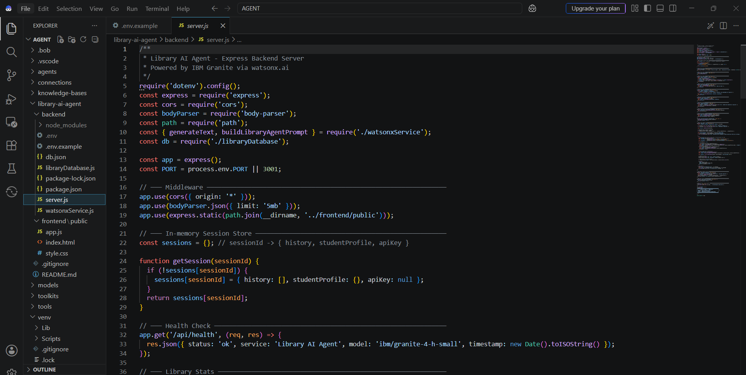

Slide 8
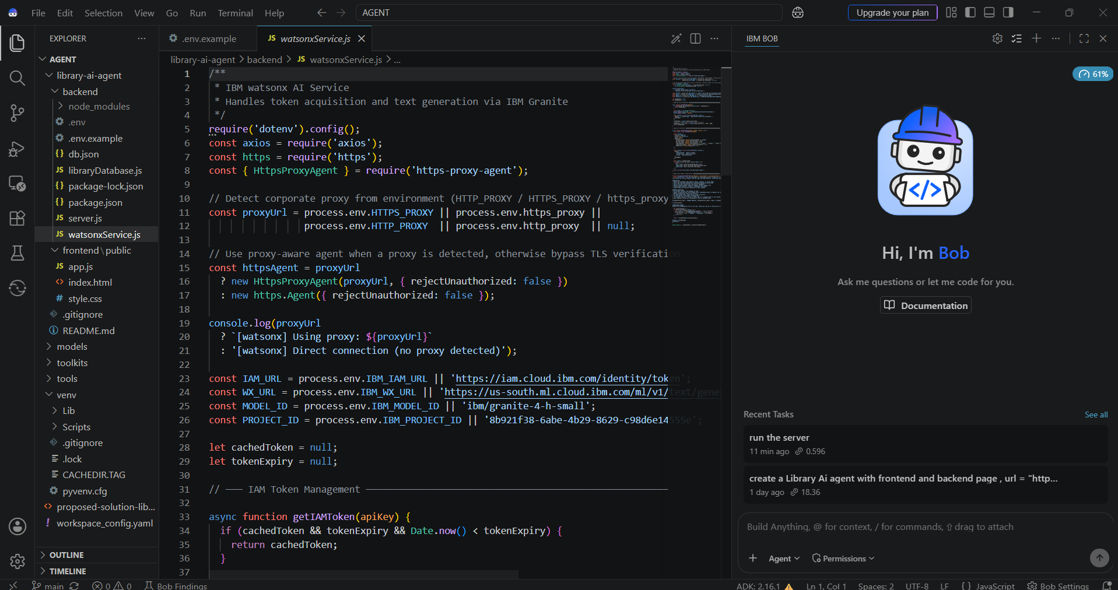
IBM Bob Screenshots:

Slide 9
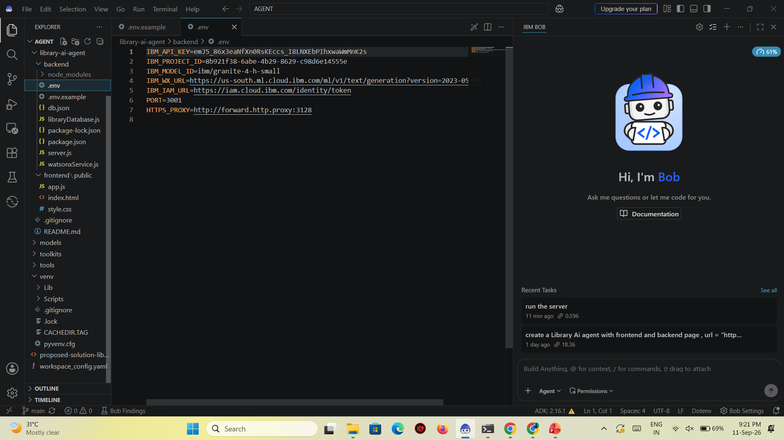
.env

Slide 10
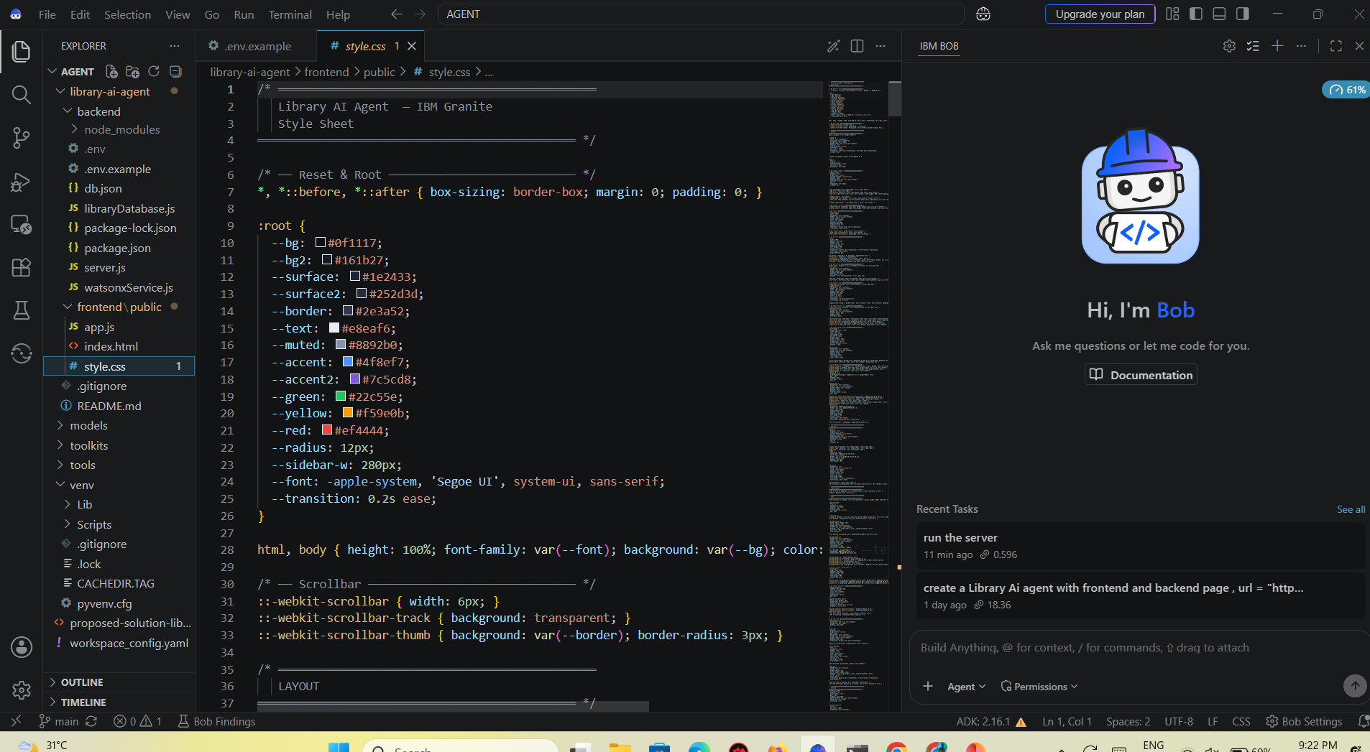
Style.css

Slide 11
watsonx.ai Components Used -
1) Chat Input – Interface where students enter their queries in plain English, such as course topics, book names, or study needs, to interact with the Library AI Agent.
2) IBM watsonx AI Agent - Processes the student's input using the IBM Granite model to understand the academic context, search the library catalog, and generate personalized book recommendations with availability status.
3) Name of IBM Granite Model - ibm/granite-4-h-small → Fast, efficient for real-time library search, natural language understanding, and student query reasoning.
4) Chat Output - Displays AI-generated responses such as book recommendations, availability counts, shelf locations, reservation confirmations, and waitlist status messages.
5) Library Catalog Database (db.json) - Stores and retrieves all book records, reservation data, checked-out counts, waitlist queues, and student notification history for real-time access and persistence across server restarts.
6) IBM IAM Token Service - Handles secure authentication by converting the IBM API Key into a Bearer Token before every watsonx.ai API call, ensuring all AI requests are authorized and secure.
7) Reservation & Waitlist Engine - Automatically manages book reservations, tracks waitlist positions, promotes the next student when a book is returned, and triggers real-time in-app notifications without any manual intervention.
8) Notification Component - Delivers instant in-app alerts to students the moment their waitlisted book becomes available, showing a red unread badge in the sidebar with the message, shelf location, and 48-hour collection window.

Slide 12
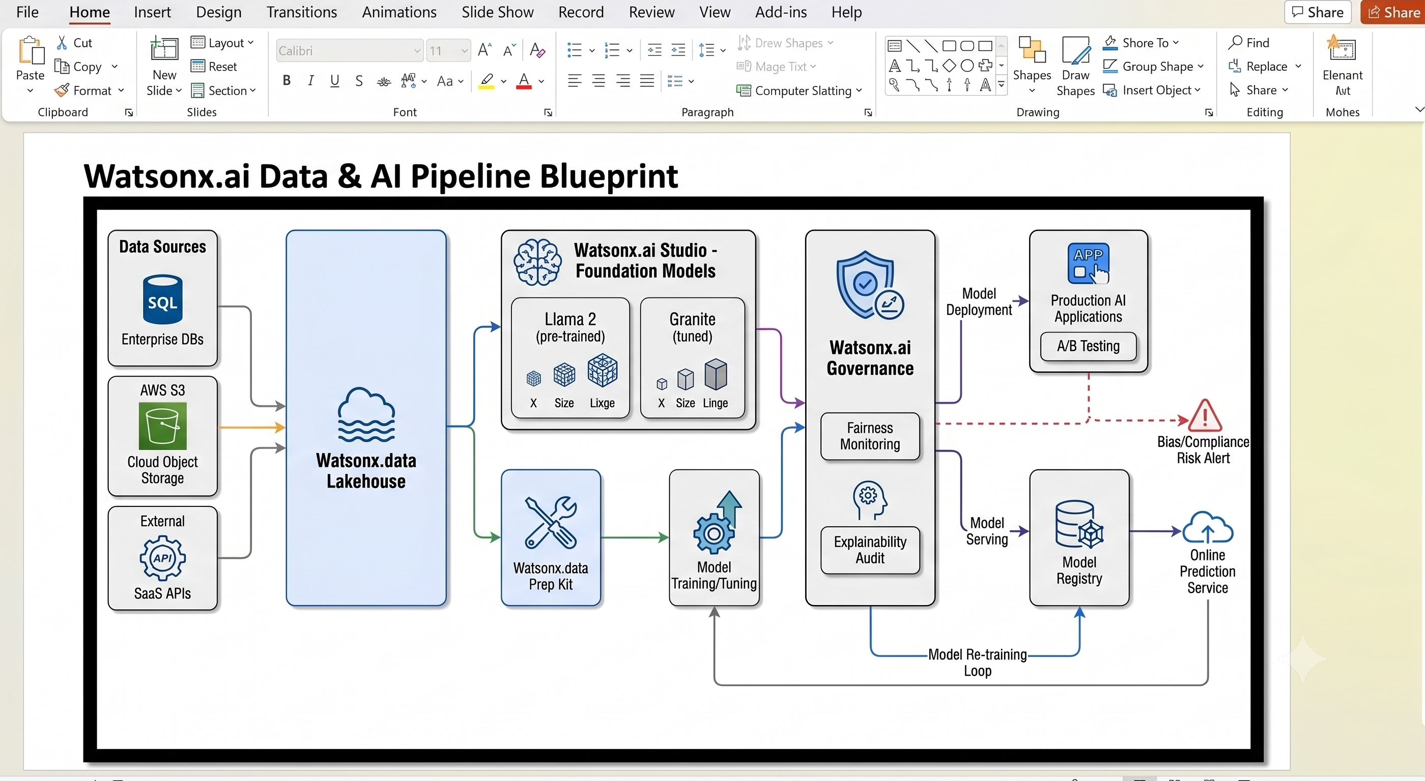
Watsonx Ai workflow-

Slide 13
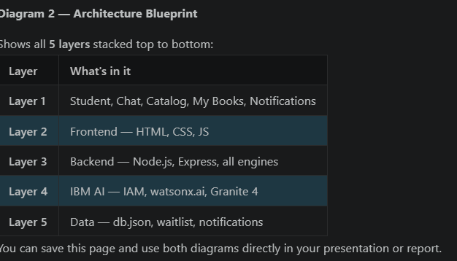
Architecture blueprint

Slide 14
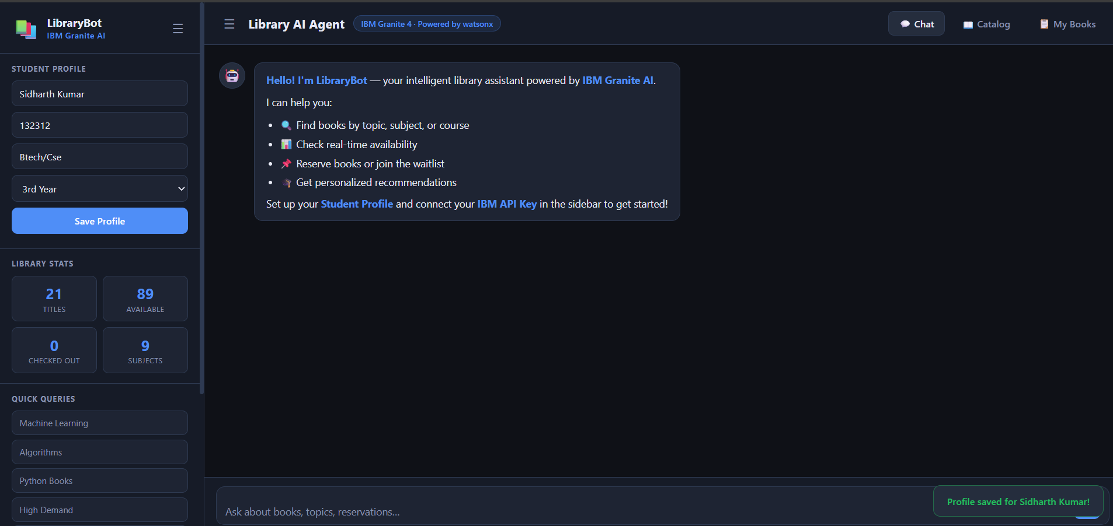
PROJECT OUTPUT SCREENSHOTS

Slide 15
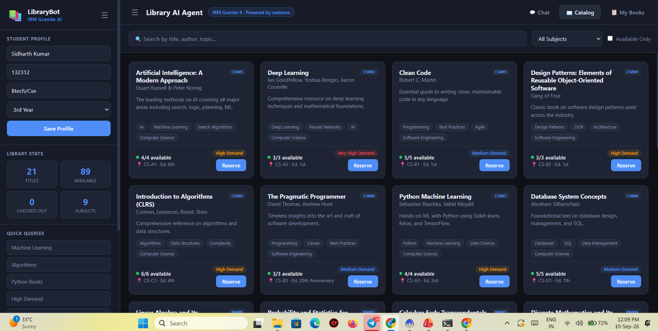

Slide 16
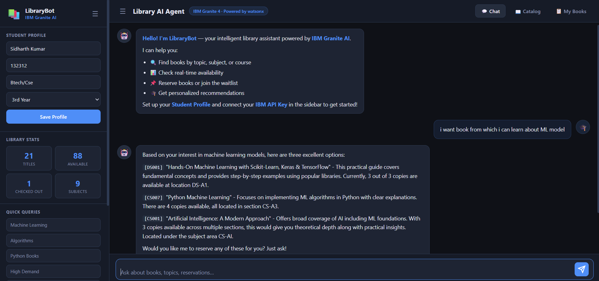

Slide 17
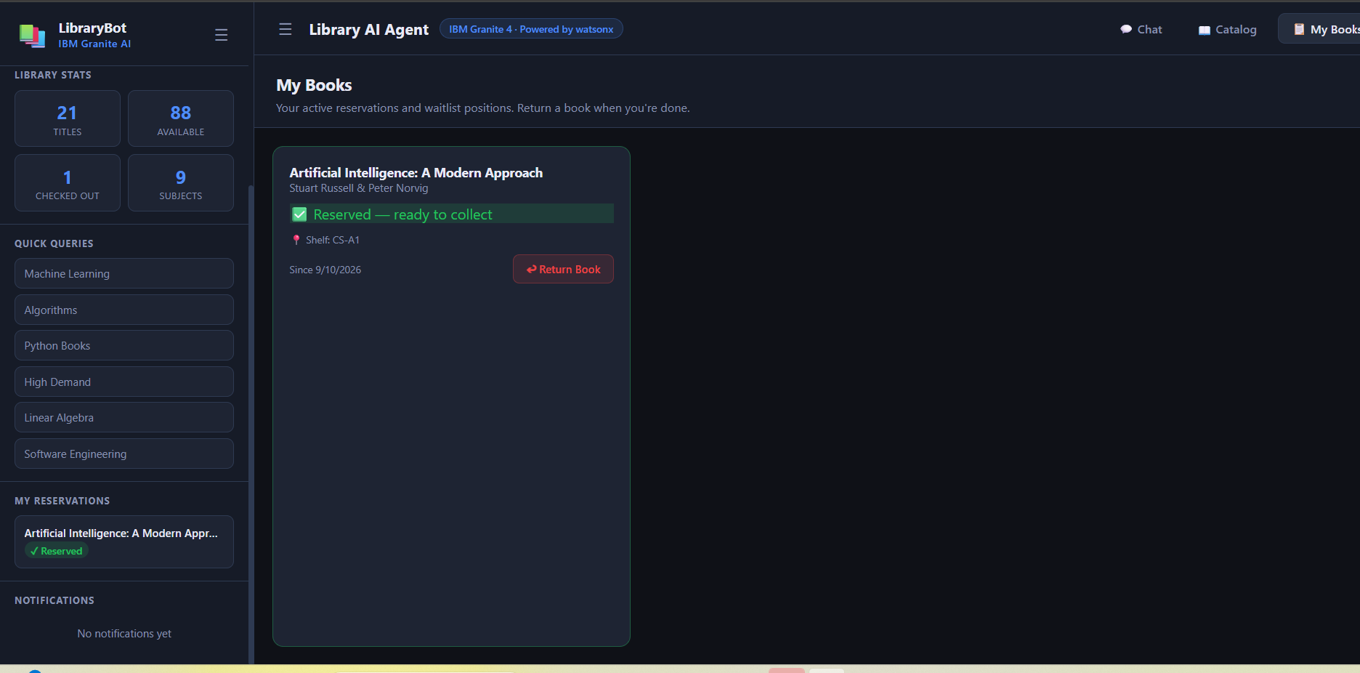

Slide 18

Role of Agentic AI in the solution
Role of Agentic AI in Library Agent
Perceives intent — understands "I need books for my exam" not just keywords
Reasons over catalog — picks the best match from 21 books using live data
Takes actions autonomously — detects "reserve CS007" in chat and executes it
Manages full lifecycle — return → waitlist promote → notify, all without human input
Remembers context — conversation memory across the session
Personalizes — adapts recommendations based on major and year of study

Slide 19
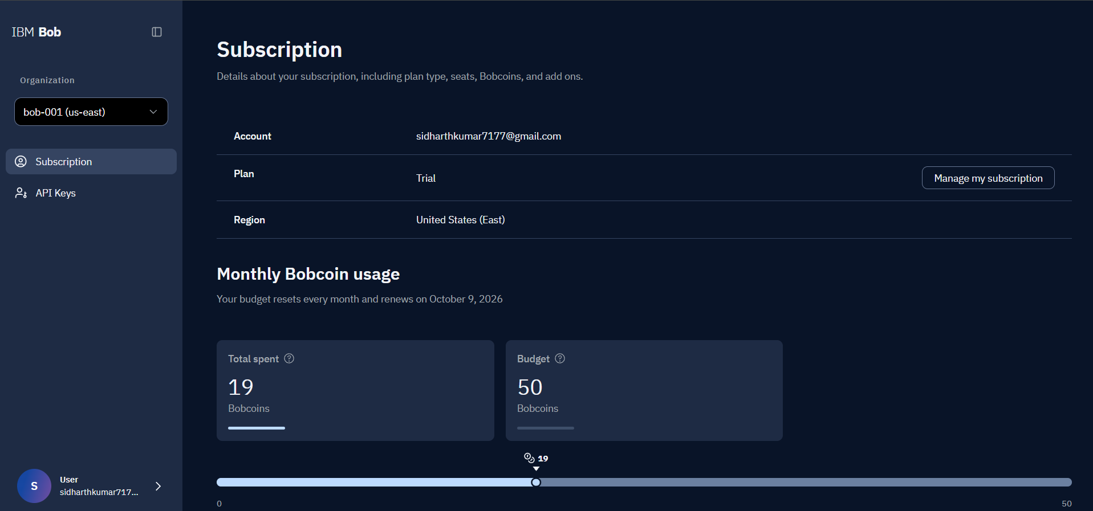
Token Usage IBM BOB
·
·
·

Slide 20
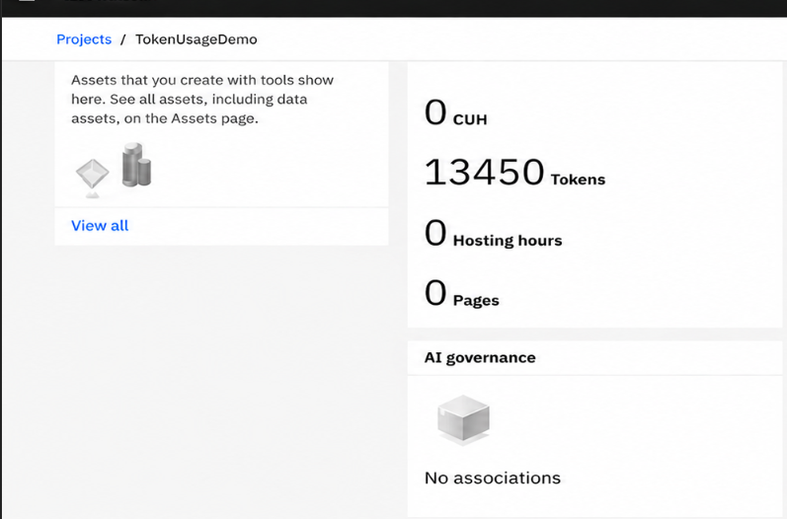
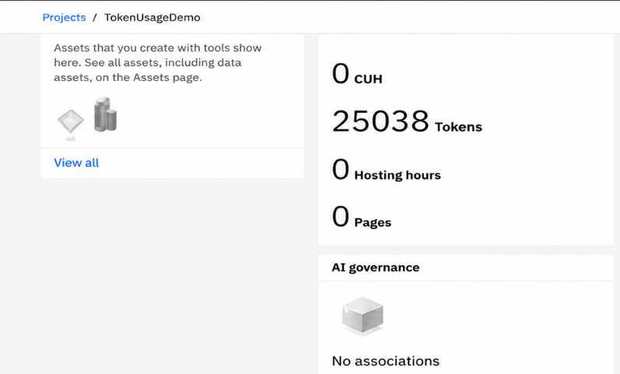
Token Usages-
Token used = 11588
Before After

Slide 21
Novelty and Uniqueness
Novelty-
No AI hallucinations — only recommends books that physically exist
Natural language as the only interface — system adapts to student, not vice versa
Waitlist auto-fulfilled the instant a book is returned
IBM Granite used as a domain-specific academic library agent
Uniqueness-
End-to-end in one system — no other tool covers the full journey
Zero infrastructure cost — runs on IBM Cloud Lite, completely free
AI knows what it does NOT have — uniquely honest and trustworthy
No heavy frameworks — pure prompt engineering, lightweight and transparent
Designed specifically for how real university libraries work

Slide 22
Git Hub Link
Please create public github repository (Enable Add README button while creating repository) with format –
Please test and Paste the working Github URL – https://github.com/Sidharth6834/Library-Ai-Agent
Make sure you have Uploaded following three files into your github repository
1) app.json file , 2) yourproblemstatement.pdf file 3) your projectpresntation.pptx file 4)any other files
·
·
·

Slide 23
Future Scope
Multi-language support — Hindi, French, Arabic via IBM Granite
Voice input — speak your query instead of typing
Course syllabus integration — AI auto-reserves books from your syllabus
Book ratings & reviews — students rate books, AI learns from it
LMS integration — connect to Moodle, Blackboard, Canvas
Digital & e-book recommendations — beyond physical books
·
·
·

Slide 24
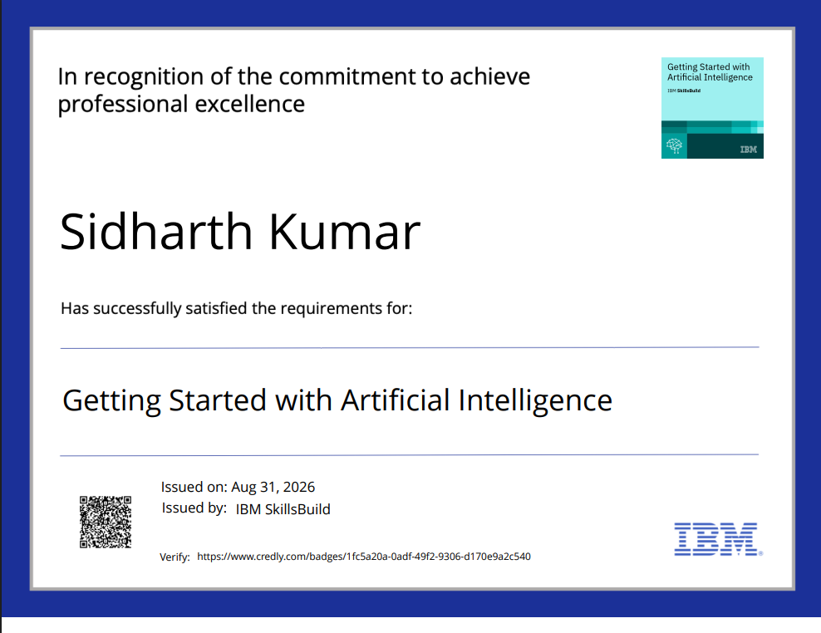
Certificates Earned:
Please add your credly certificate

Slide 25
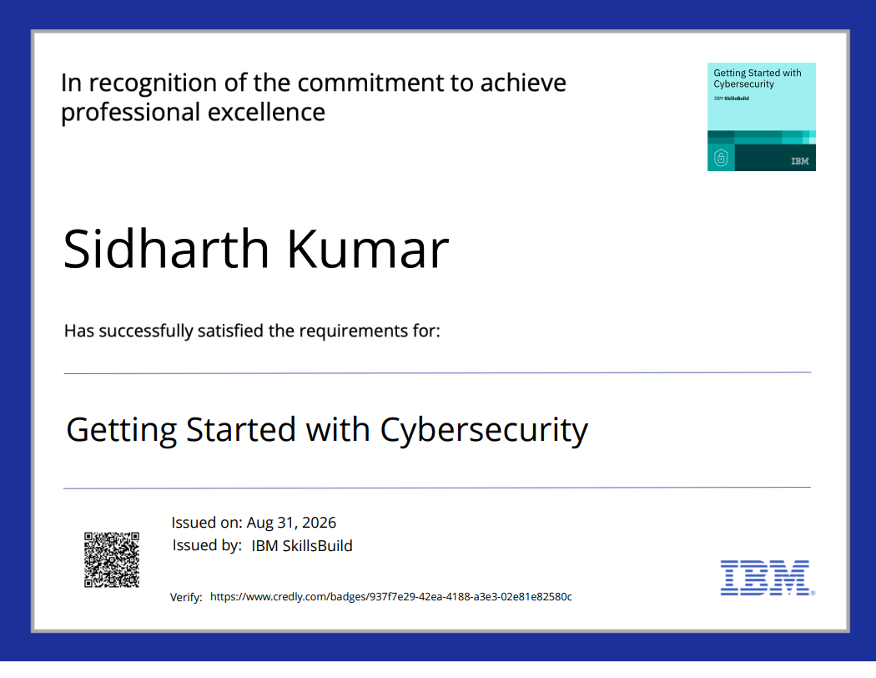

Slide 26
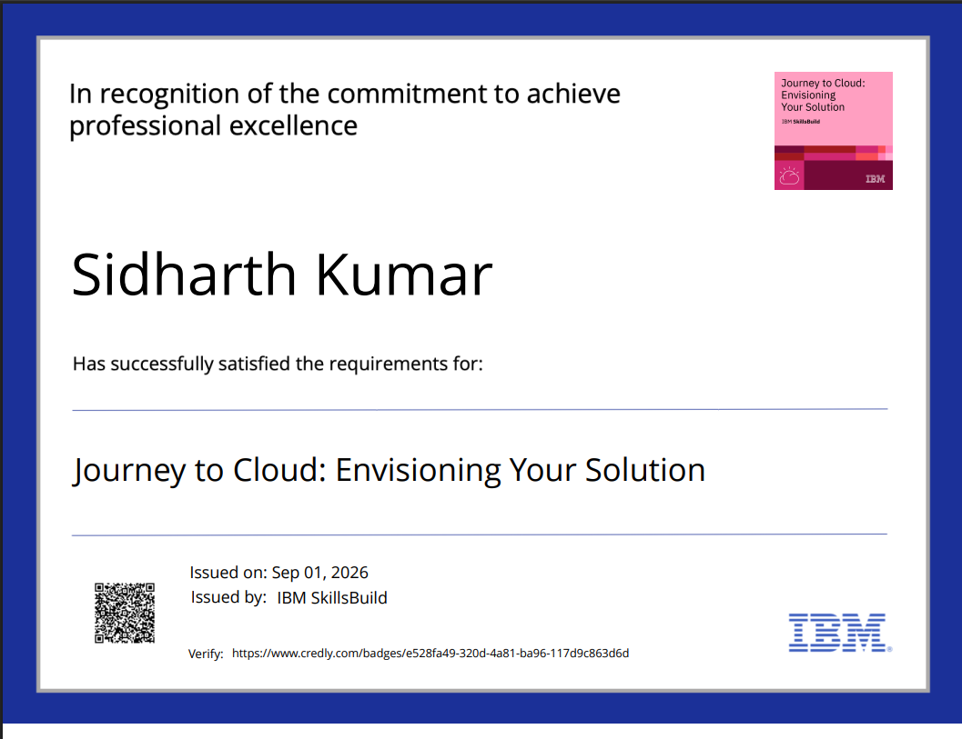

Slide 27
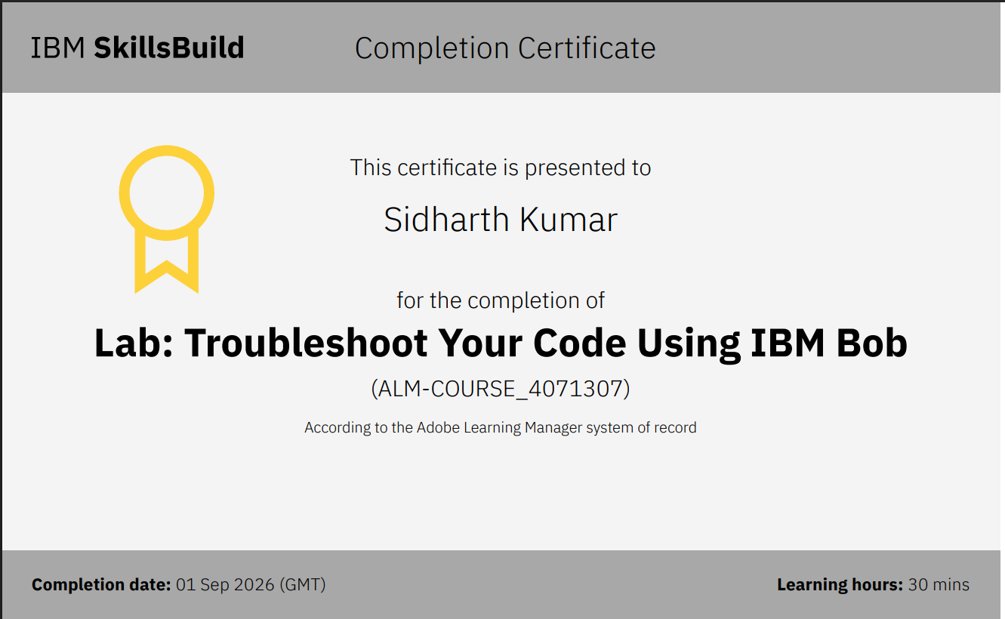
Certificates Earned:​
Add your IBM BOB Certificate

Slide 28


